Slide 1
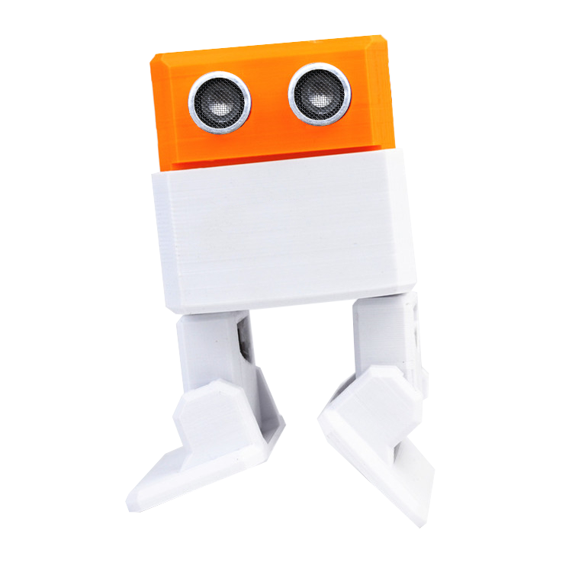
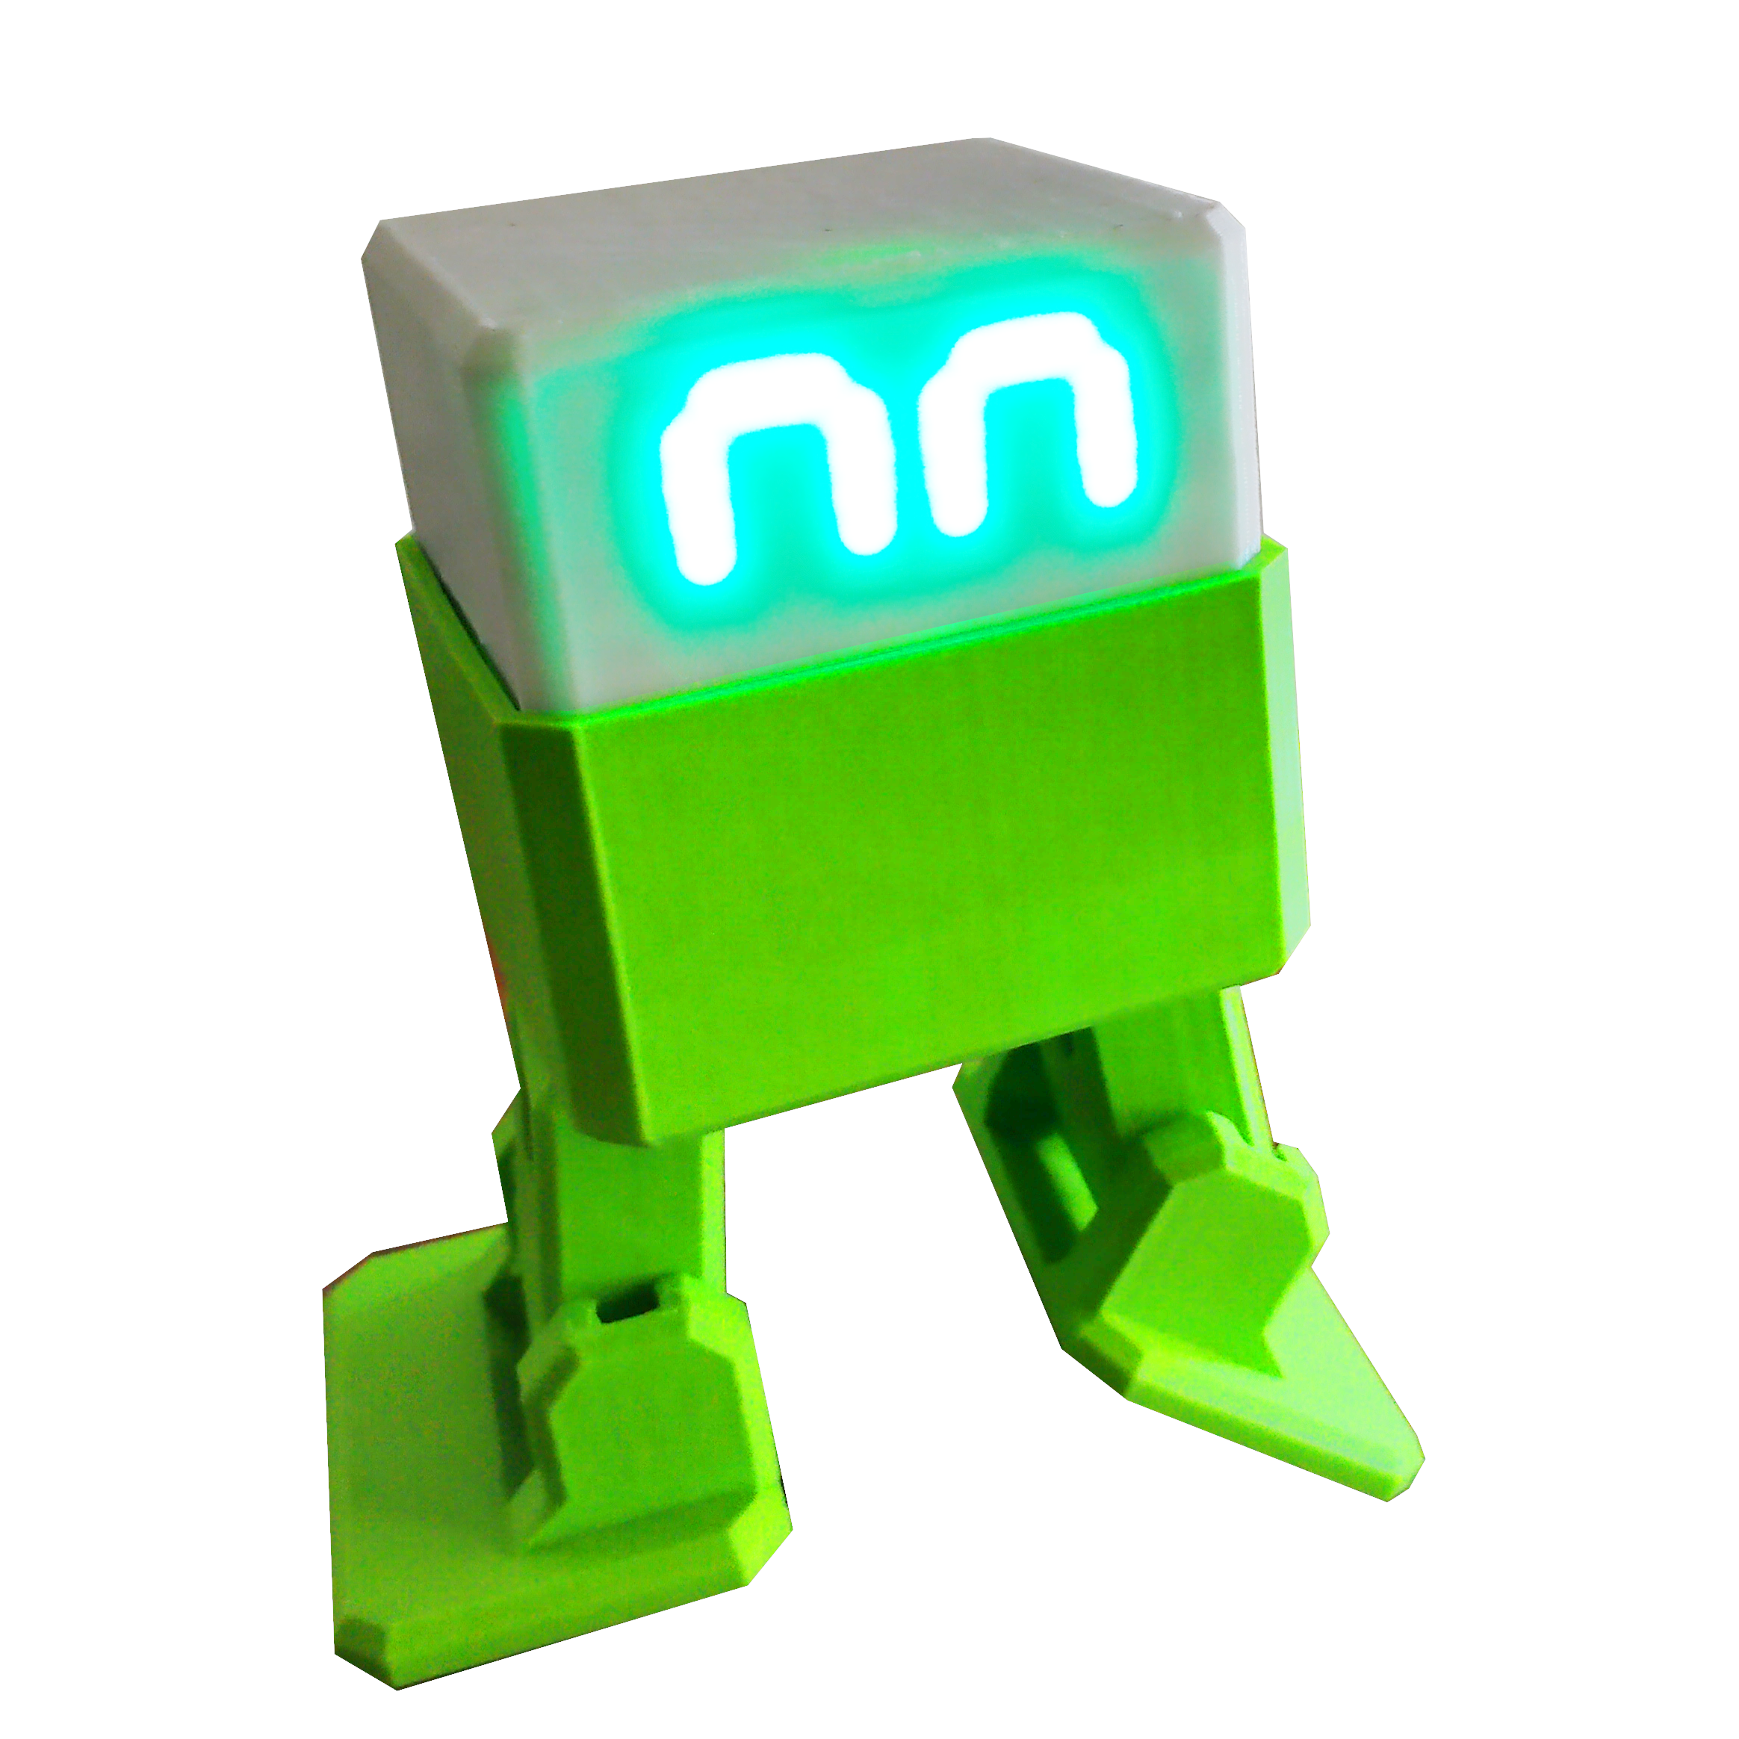
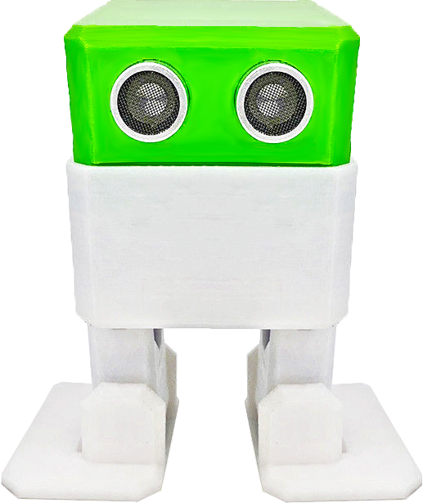
Getting started with Otto DIY robots

Slide 2
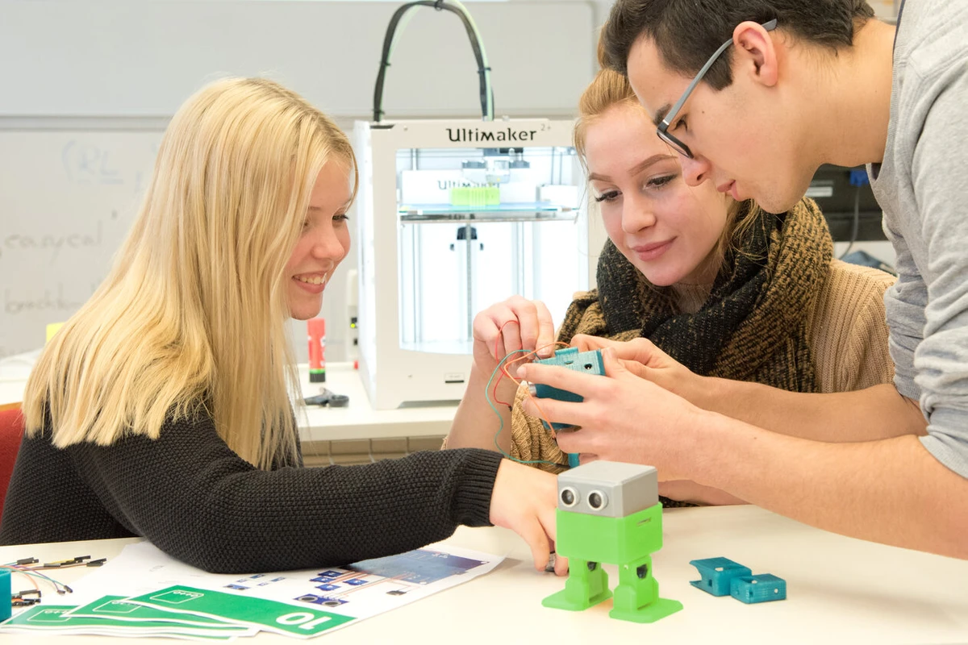
Index
Introduction
Types of Otto robots
Precautions
Servo Motors care
Build your own robot
Other PPT
Otto Blockly guide
Otto Arduino Setup/Libraries
Bluetooth control setup
Calibration of servo motors
Find Help in the forum

Slide 3
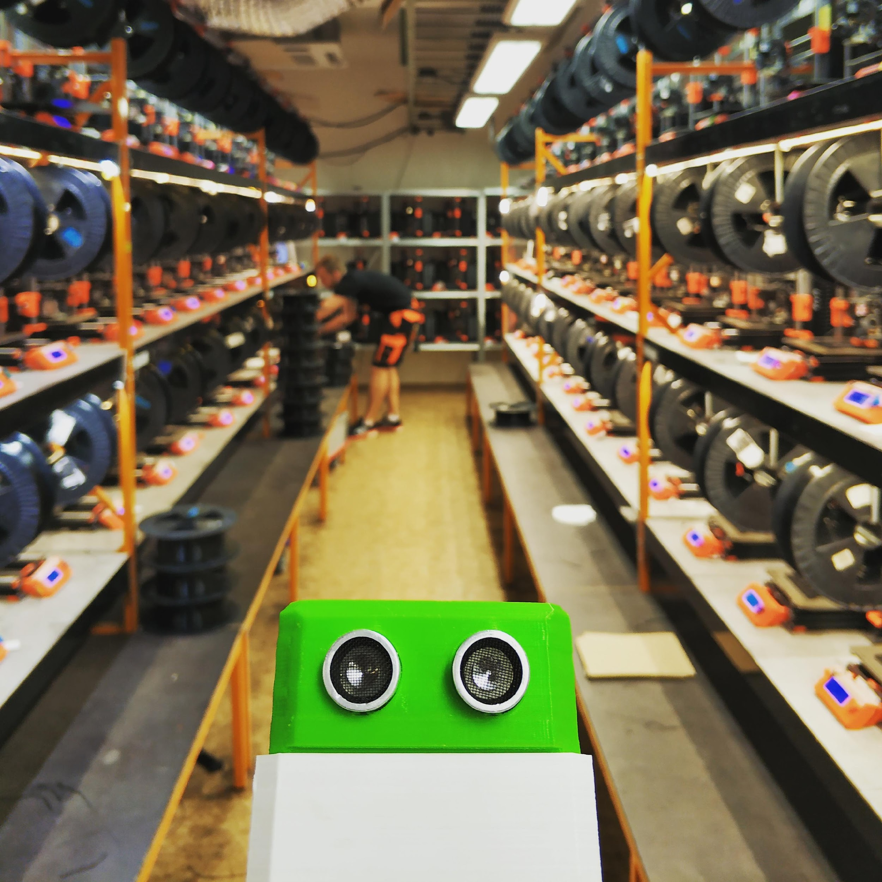
About Otto DIY
Otto DIY is headquartered in Czech Republic, where the term robot and the best open source 3D printer was created.
Thanks to Otto DIY open source nature, it has become one of the most popular 3D printable robot designs in the world due to its simplicity. Otto is the first-ever OSHW (Open Source Hardware) certificated project from the Czech Republic.
We are now 3D printing our robots in Europe.

Slide 4
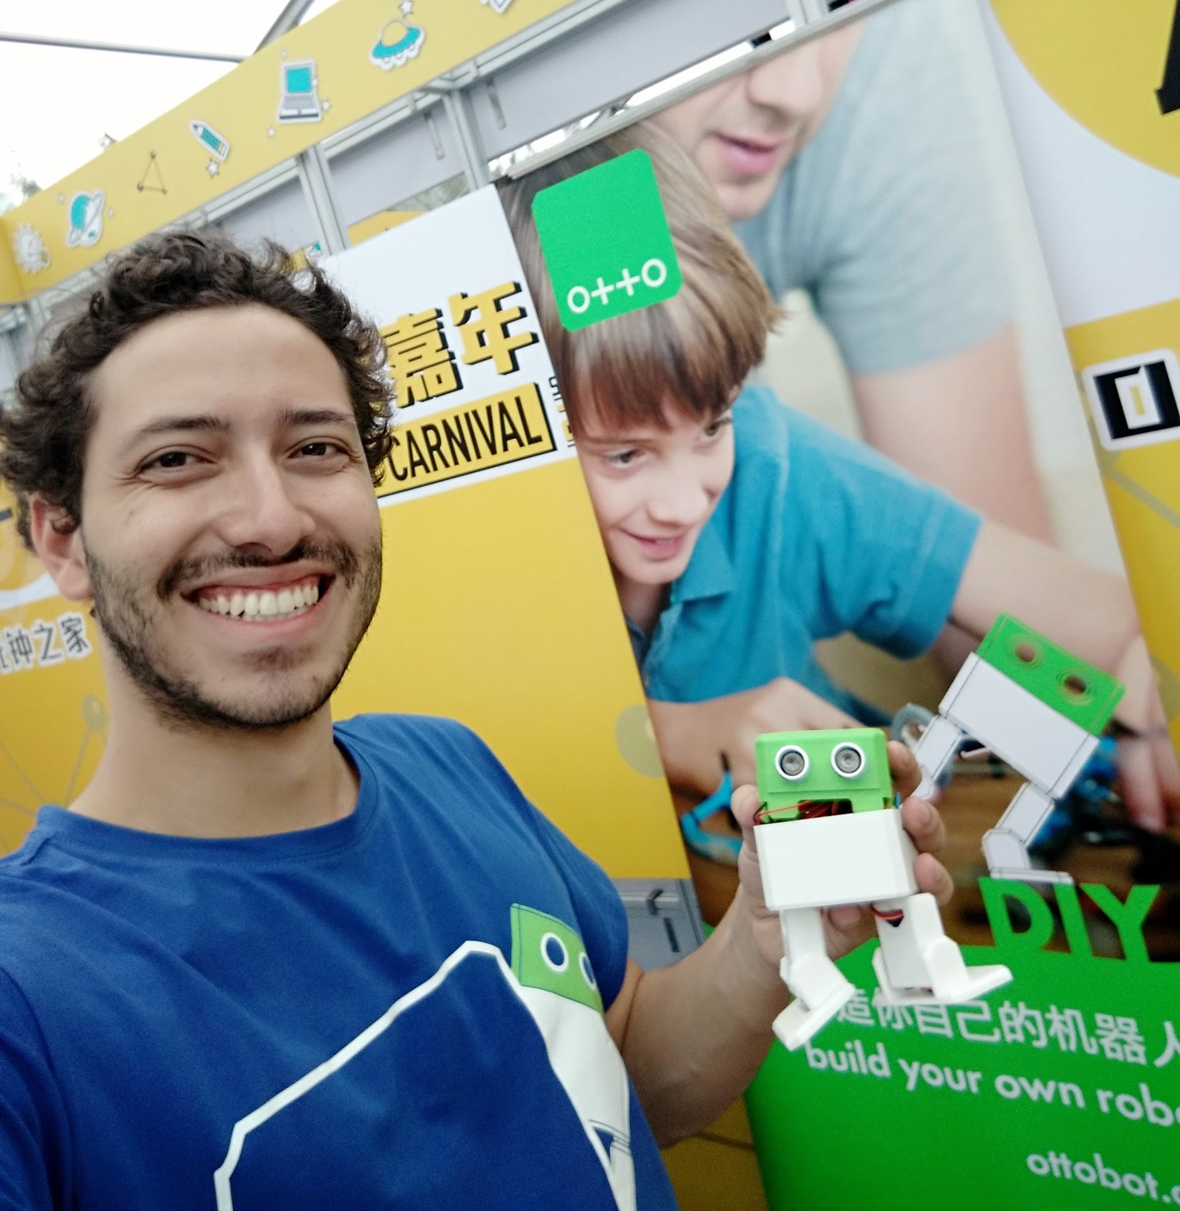
About the creator
Otto DIY robots have been designed by robotic enthusiast Camilo Parra, using his skills as a Product Design Engineer while working in Shanghai, China for a multinational toy manufacturer in 2016.
At Xinchejian (新车间) hackerspace in China, Camilo started to learn and experiment with making DIY robots using microcontrollers, servo motors and 3D printers.
Soon he created an inexpensive, Beginner's robot called “Otto”, easy to build and code for children.

Slide 5
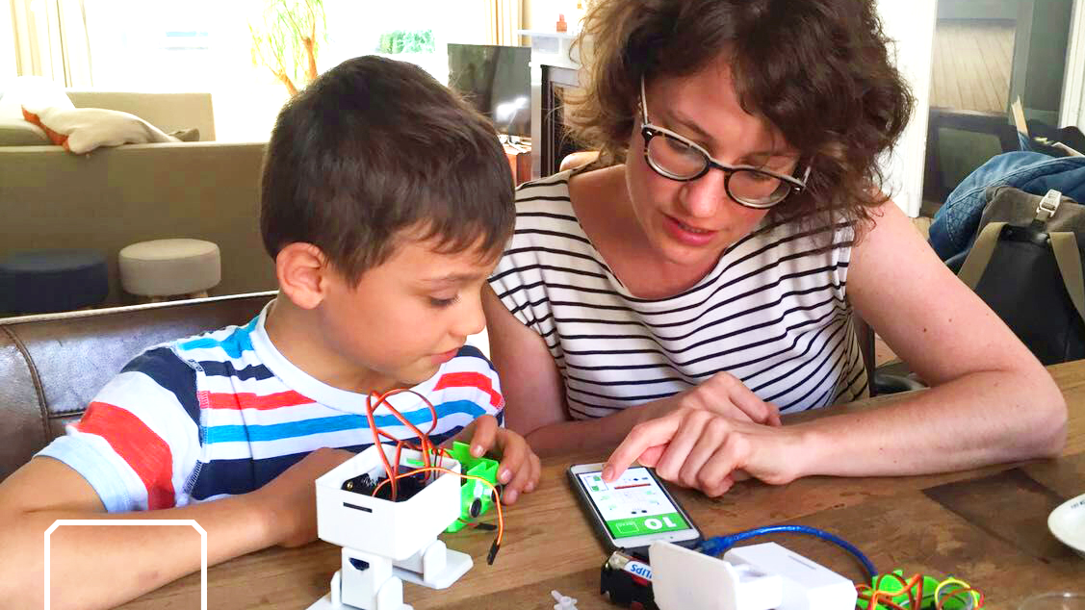
Build, Code, Design & Create
your own robot
😎

Slide 6
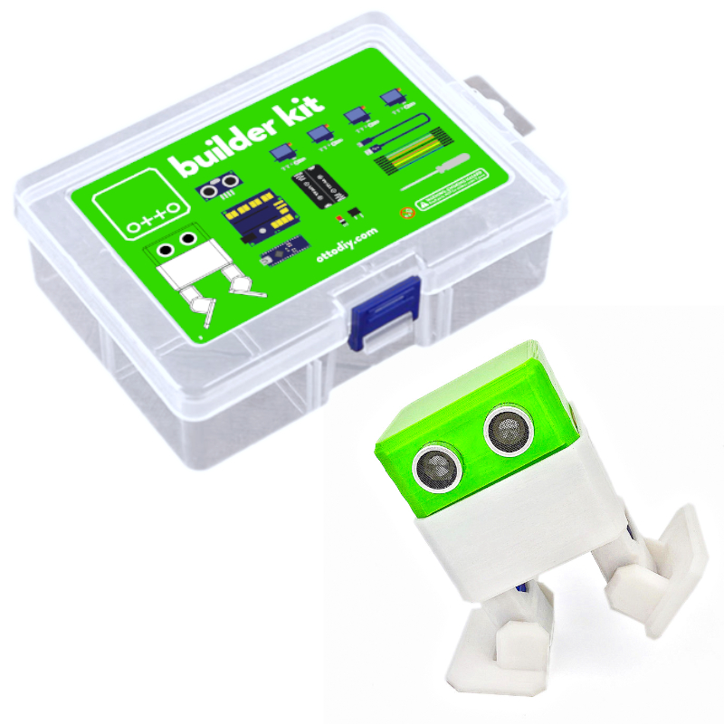
Introduction
Thank you for purchasing an original Otto DIY robot kit from us! Your purchase supports us in the further development of Otto and our educational mission. Builder kits are our smart and affordable educational robots, which include everything you need to get started into robotics.
Because Otto is designed for easy 3D printing, we alternatively offer low cost Maker kits for those who own or have access to a 3D printer. Please, read the guides carefully, since all pages contain valuable info regarding the use of the parts, getting started, instruction manuals, 3D printing tips and the basics of coding. You will enjoy the process!

Slide 7

Features
As a base all our robot kits Otto teaches to everyone how technology works while having fun. After built with our easy to follow instruction manuals and videos, all Otto's can walk, turn, dance, makes sounds and fully programmable with our Otto Blockly graphical coding or Arduino IDE.
From there, it adapts to the rhythm of the learner who can play, improve and control it. Our robot kits have more or less capabilities but you can always upgrade them!
Easy to build or create your own projects. personalize with papercraft or 3D printing. Post your creations in the Otto Builder community.

Slide 8
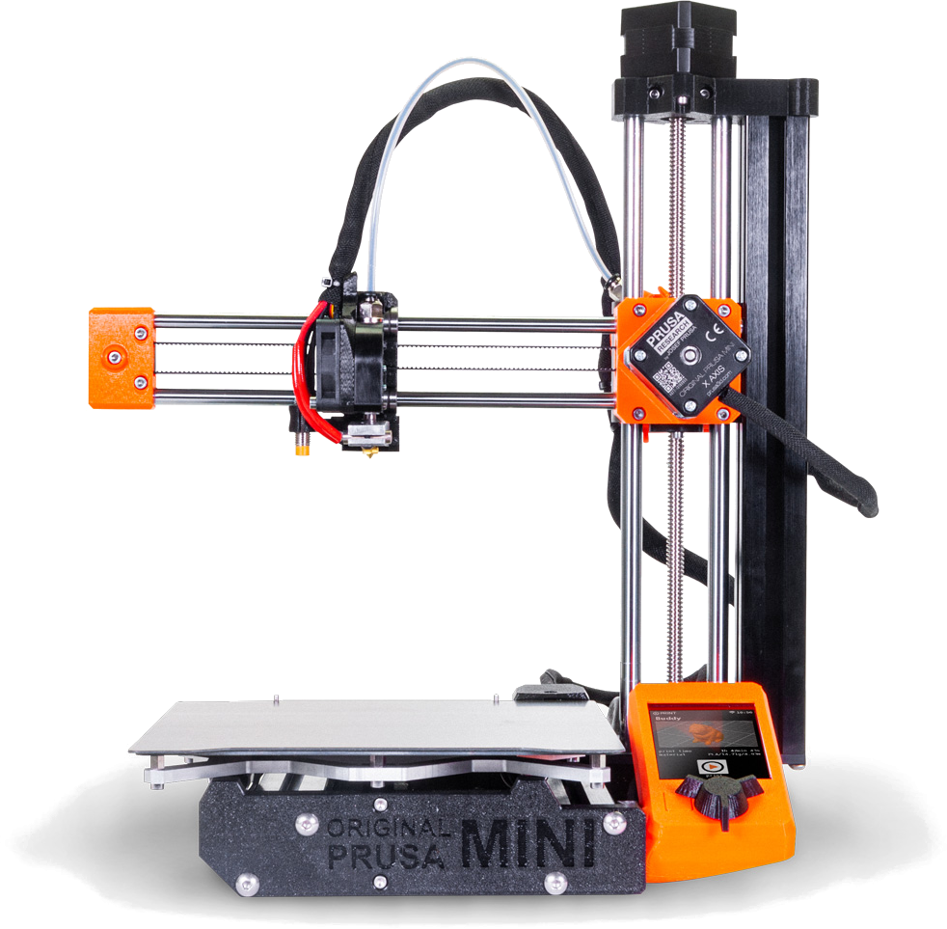


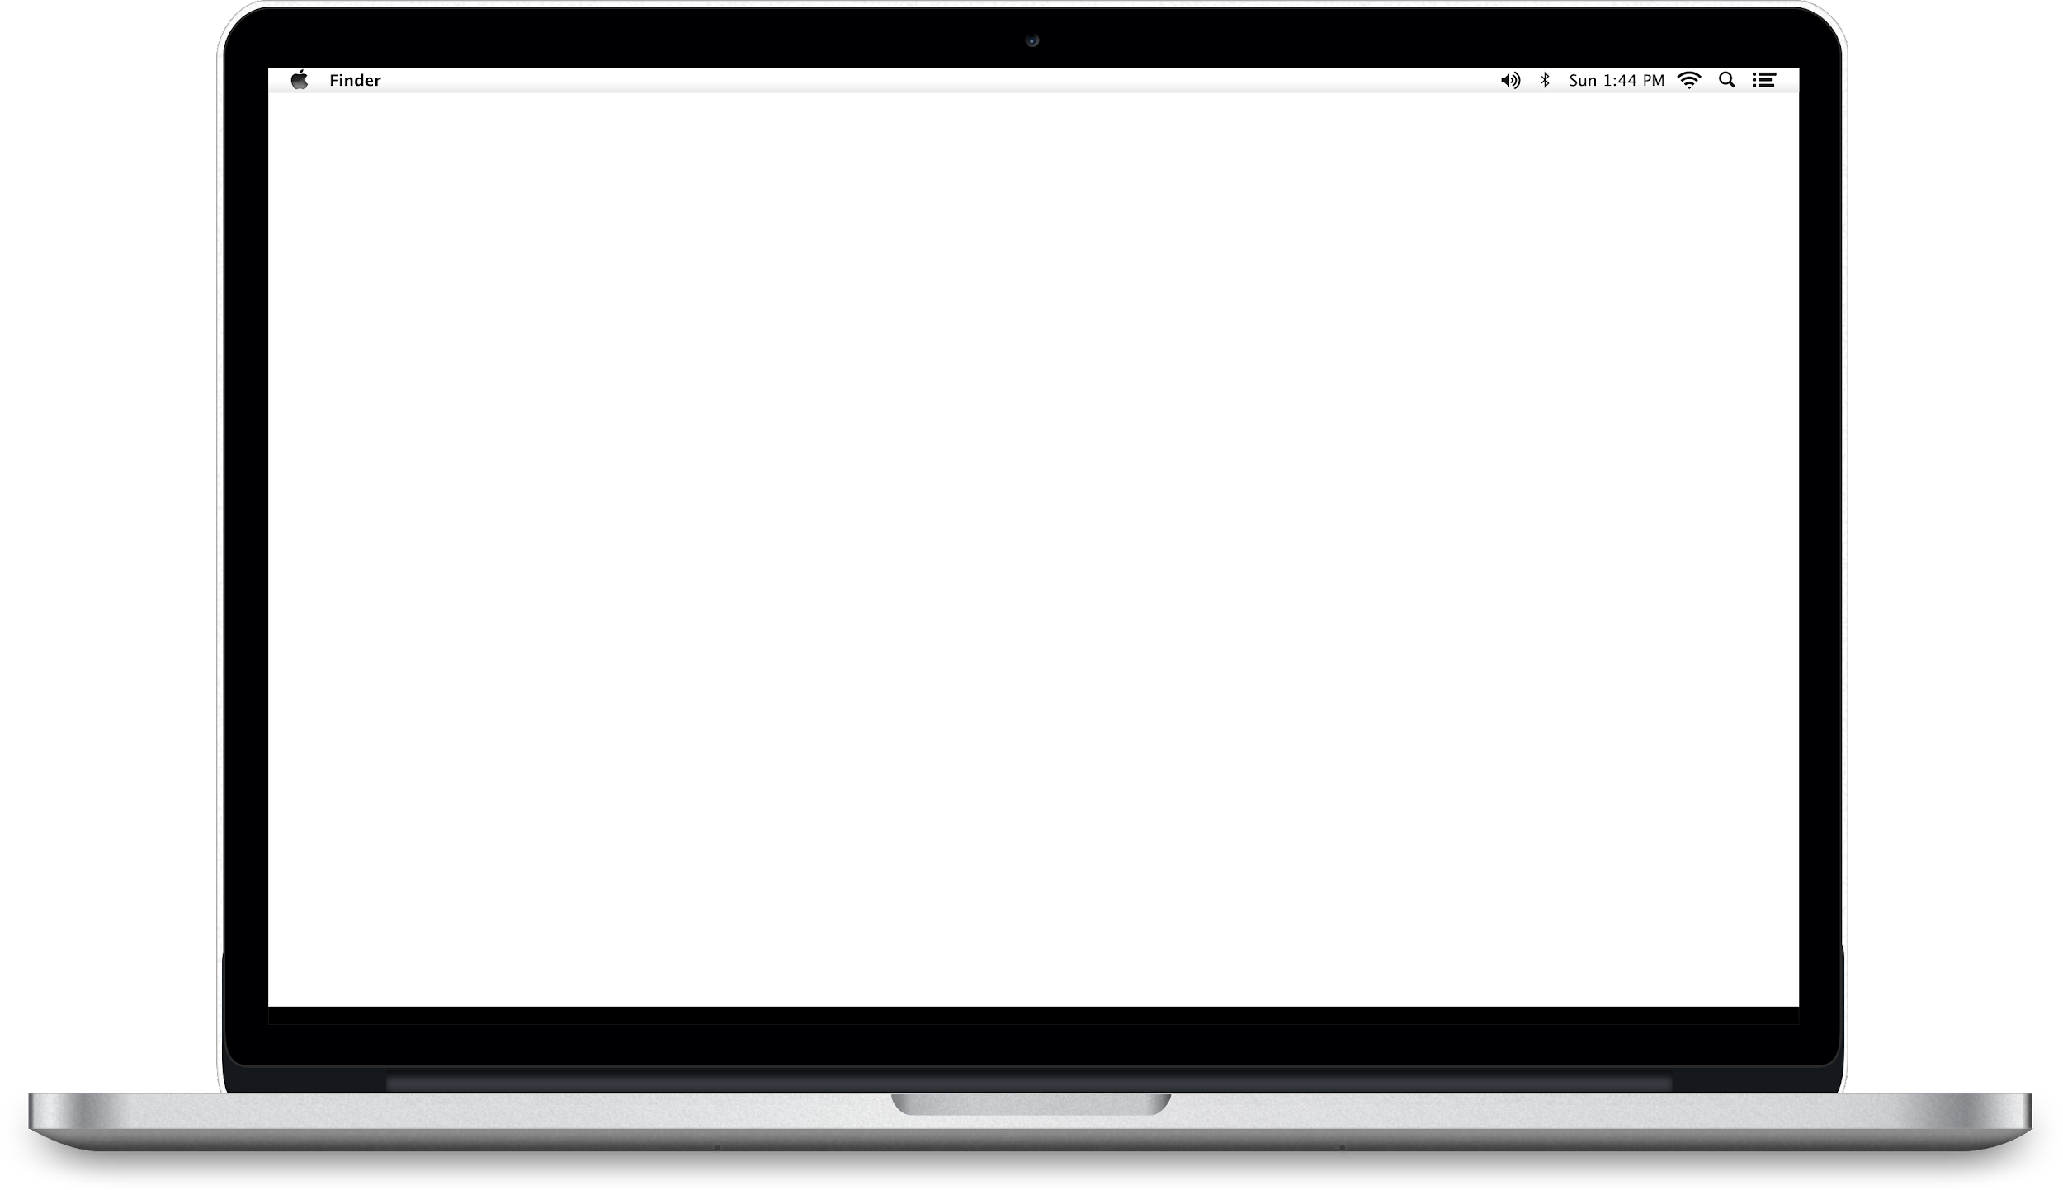
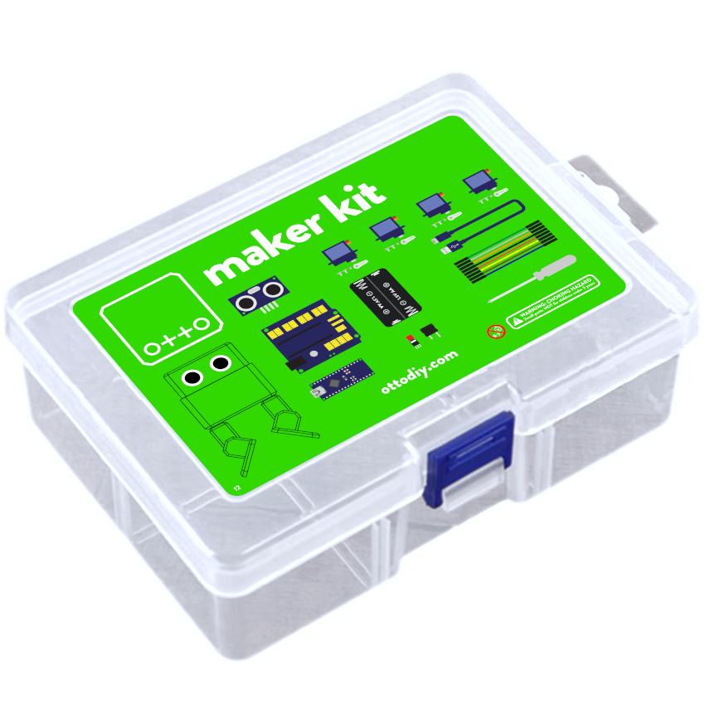
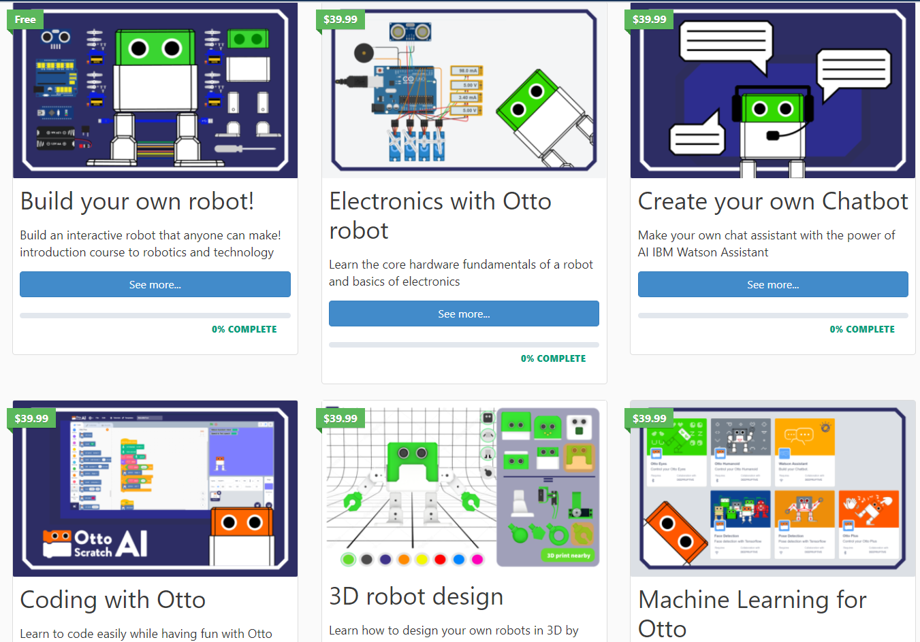
The path to become a Creator
Build, Code, Design & Create
your own robot
Learn the skills of the future
(coding, engineering, electronics, digital fabrication and design)
Notes:
The Maker kit comes with all electronic components so that you can 3D print the robot shell at home in any color you want. Our builder kit is mainly for families without a 3D printer, it includes the robot shell and everything you need to assemble in just an hour. Both have manuals and full documentation so that you can build them easily. In Otto Academy all education material come together with our own programming software..

Slide 9
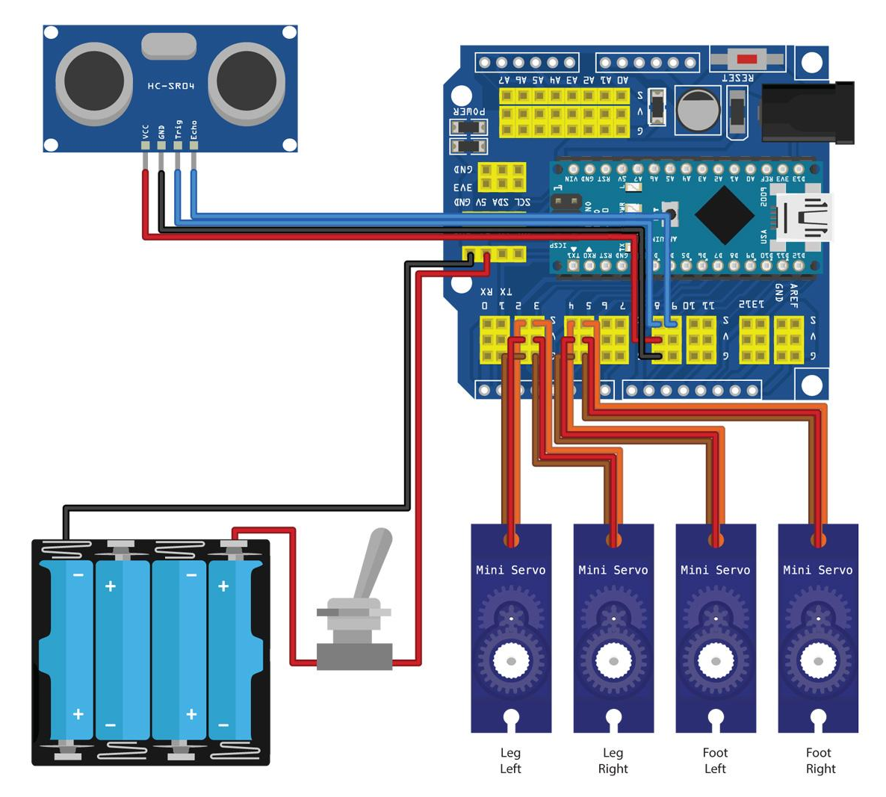
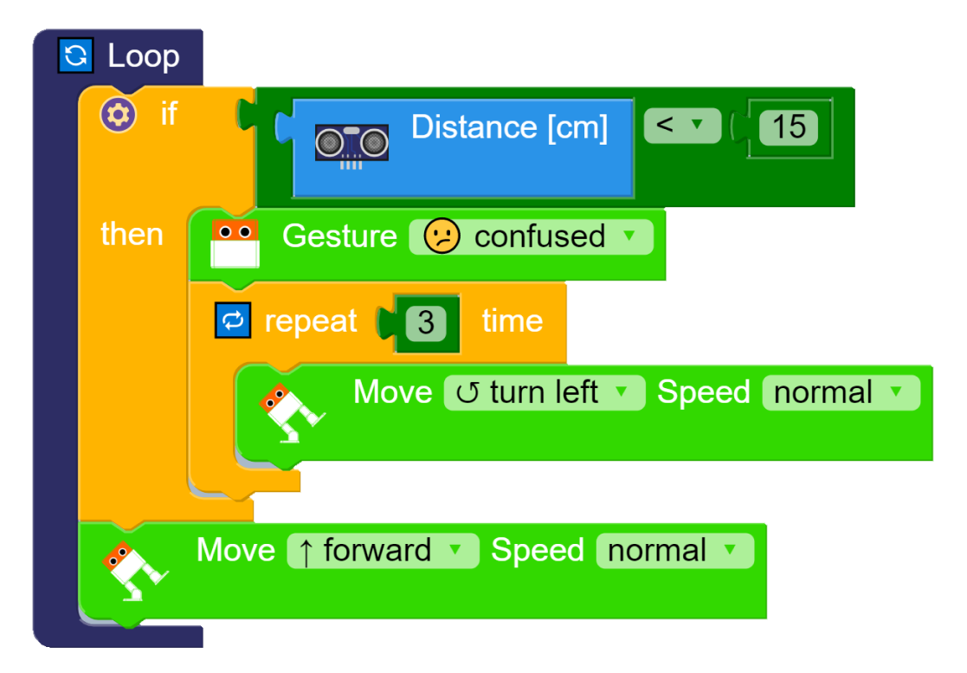
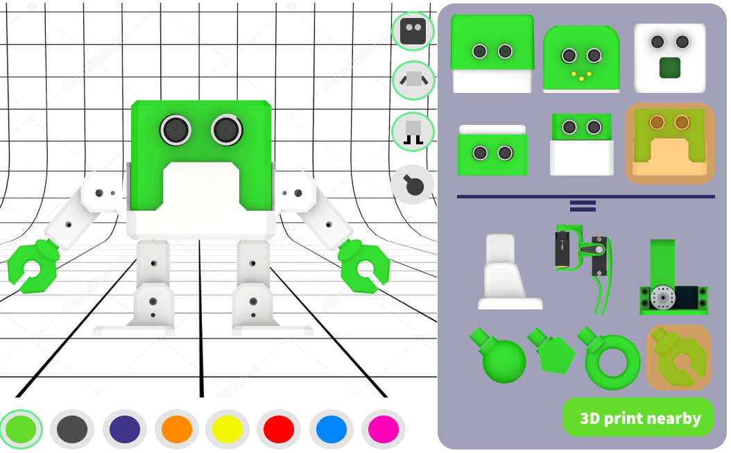
Interdisciplinary STEAM Education
👩‍🔧Engineering
👩‍💻Coding
👩‍🎨Design
Notes:
3 Pillars of learning, Electronics and Mechanics, Programming and Mat, Computer Aided Design 3D modeling & 3D printing

Slide 10
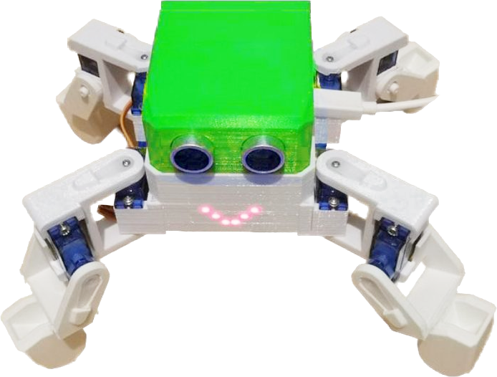
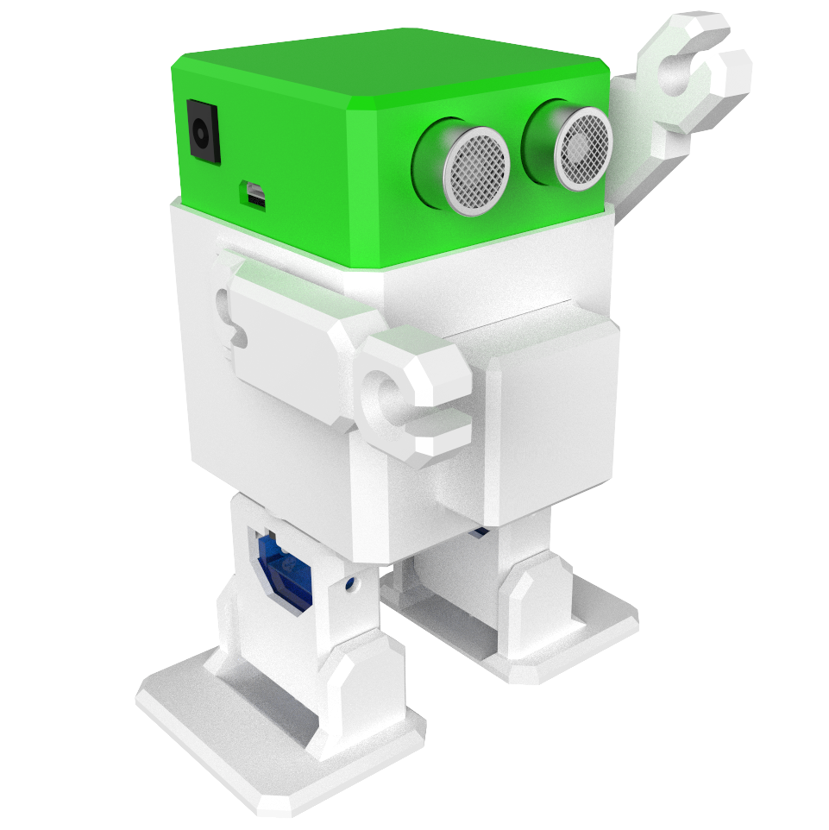
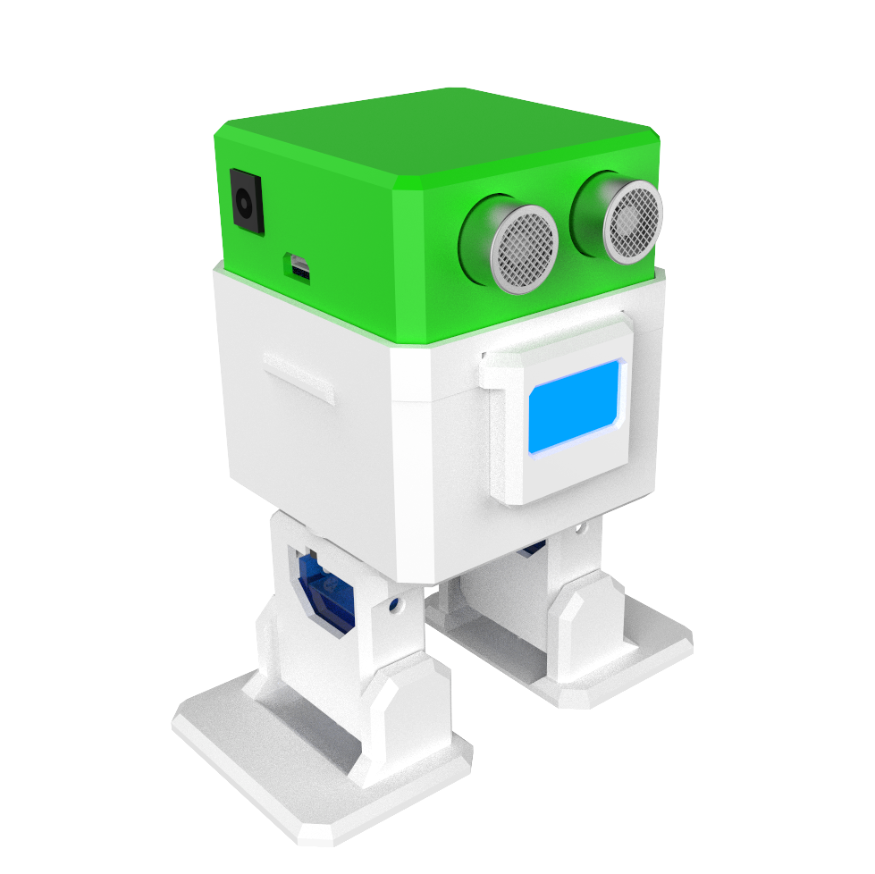
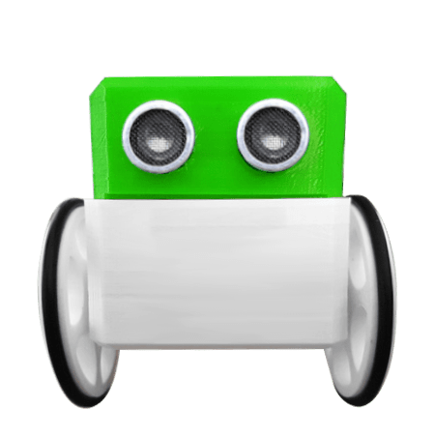
Modular robots from beginner to advanced
Humanoid
Smart
Emotions
Create your own
REMIX
¨Starter¨
Compete
Sound sense🎤
LED mouth 👅
Arms 💪
OLED mouth 🖥️
Temperature 🌡️ and Humidity 💧 sense
Touch sense 👇
LED eyes 👀
Touch sensor 👇
Bluetooth 📱
Sound sense 🎤
Ultrasonic 🦇 sensor
Wheels 🚗
Line follower

Slide 11
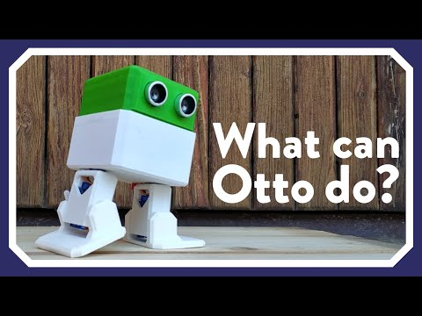
Otto
“Starter”

Slide 12
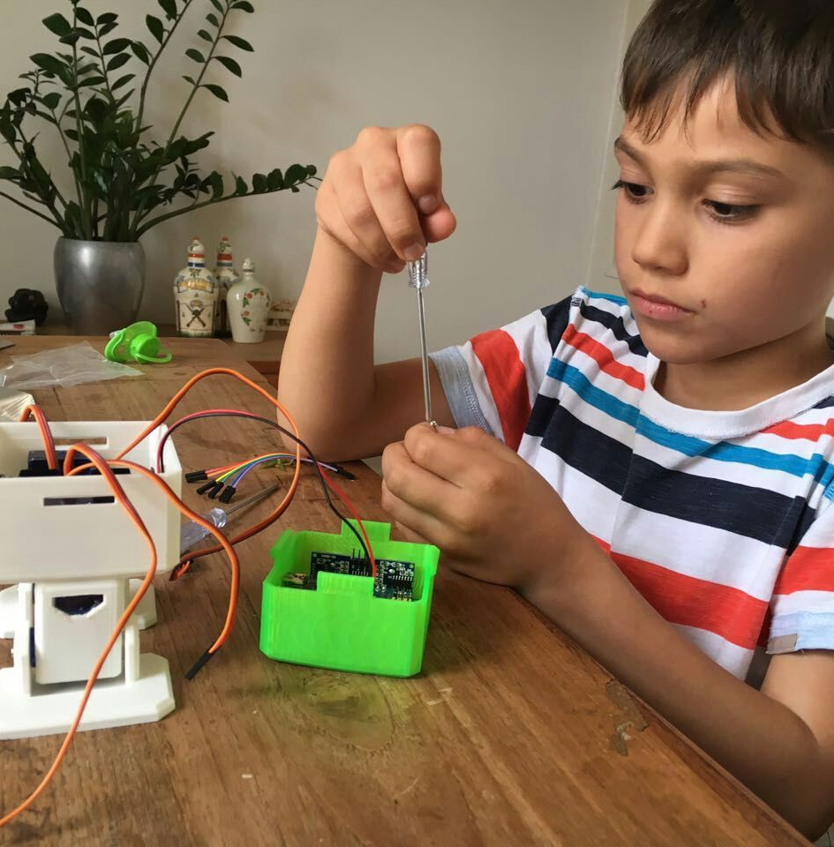
Initial warning
Please be very cautious during any interaction with the robot. This robot is an electronic device with moving parts:
The device is for indoor use only. Do not expose the robot to rain or snow.
Always keep the robot in a dry environment.
Always place the robot on a stable place, where it cannot fall or tip over.
The robot could be power with a regular PC USB port or with the provided battery in our original kits.
Do not open or reach inside the robot while it is still on. This could easily damage the electronics with short circuits. Always power off before and when opening the robot.

Slide 13
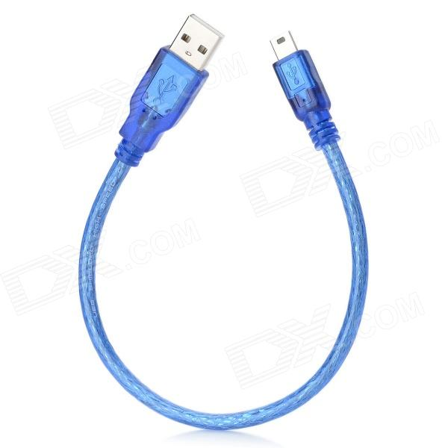
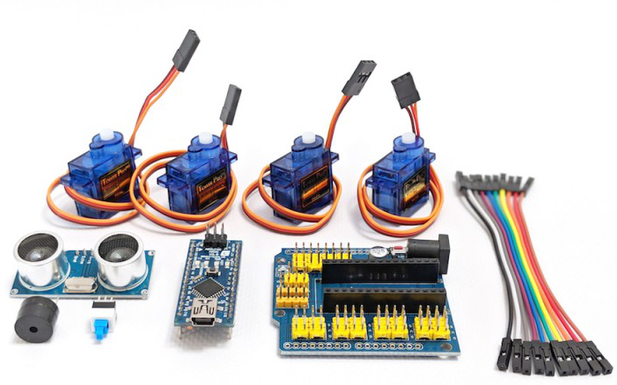
Precautions
Cable colors in the kit vary, so just connect from one pin to the right pin.
Always double check, wrong wiring can damage components, if bad smells, disconnect everything asap.
Always test and power with USB cable first before using any kind of batteries.
Be gentle with the servo motors do NOT force them to move with your hand.
3D printed parts you might need to clean them a bit in the screw holes or other areas with a file tool.
Do not use broken components.

Slide 14
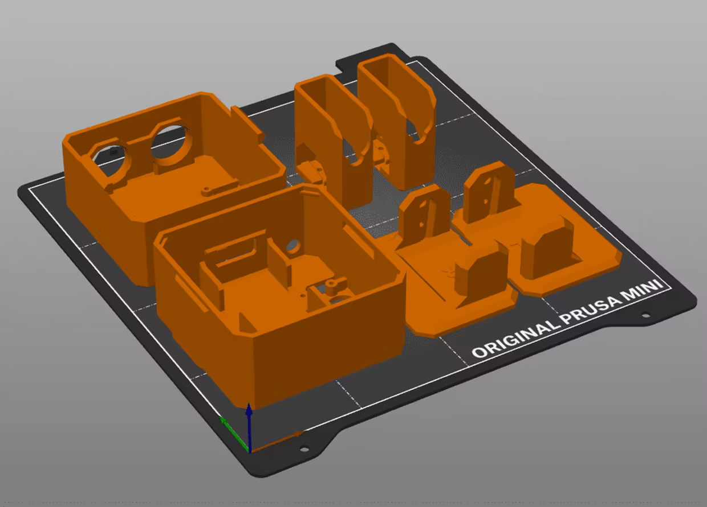
3D printing
In case that you bought one of our maker kits or you DIY your robots, you can follow this quick recommendations.
Otto is very well designed for 3D printing, the files that you had downloaded are property oriented, so it will not give you trouble.
Use a FDM 3D printer with at least 10cm x 10cm x 10cm printing volume (most have), just use regular PLA material. PETG is also ok and more flexible to assemble the snaps. Of course you can always try in other cool materials.

Slide 15
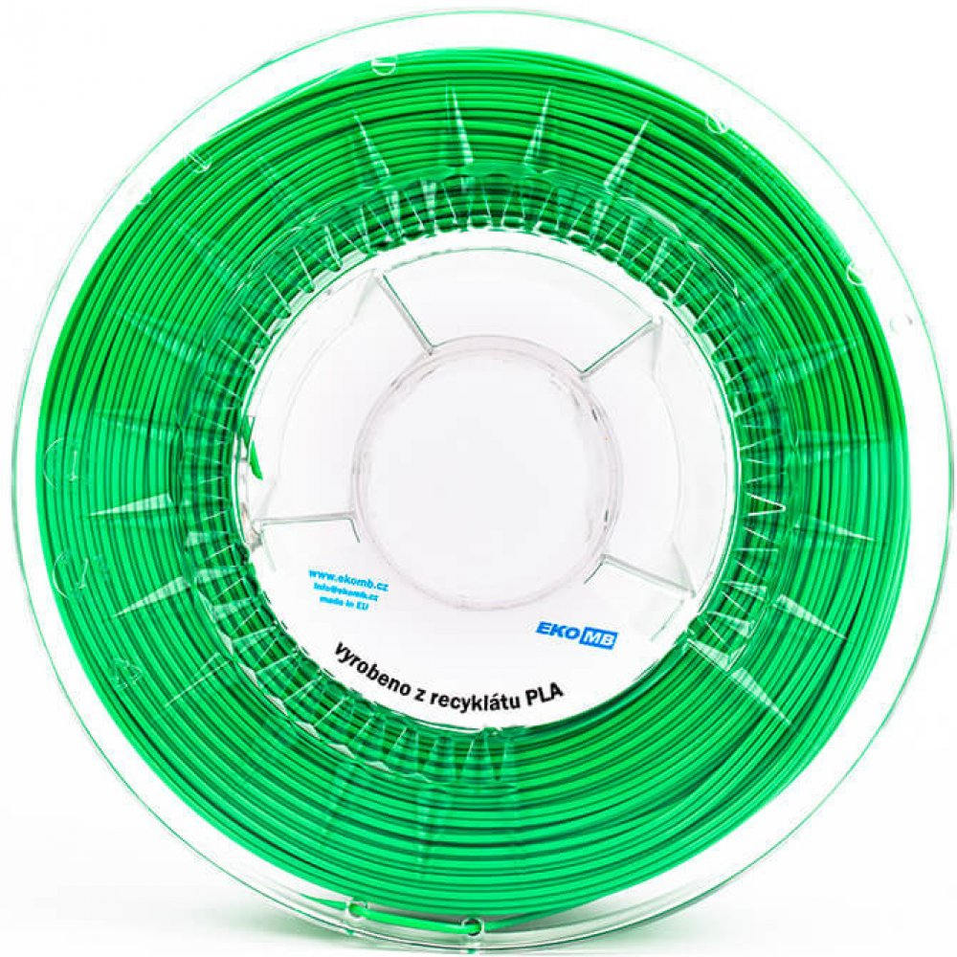
Material and time
All parts in total use 110gr approx. equivalent to 35m of regular PLA 1.75mm thickness, it should take around 6-9 hours to 3D print a full set of parts for one Otto robot, or even less with optimized settings depending on your 3D printer, nozzle and slicer parameters.
Try using a 0.6mm nozzle instead of the regular 0.4mm nozzle and it will be faster.
You can optimize these parameters by sacrificing quality, or maybe you know some tricks to balance this? Let us know.

Slide 16
3D printer setup
None of the parts require supports but in some areas like the eyes you could add supports for more precision or aesthetic finish.
Heated bed is very important for a flat head and body, it also helps to avoid wrapping in the big parts. In that case some printers might need rafts or skirt to compensate.
Make sure your printer is calibrated, some features like snaps and fittings require good precision. At the end your 3D printer and material brand/quality plays a very important role for the results.

Slide 17
3D print parameters
For slicing and generating the g code for the machine, there are many free slicer software like Prusa Slicer, you can play with the infill, bottom and top layer patterns. https://www.prusa3d.com/prusaslicer/
Resolution: 0.2mm - 0.3mm but you can make lower if you want.
Fill density 15% - 20% in any pattern, play with them if using transparent or translucent materials.
Perimeters: 3

Slide 18
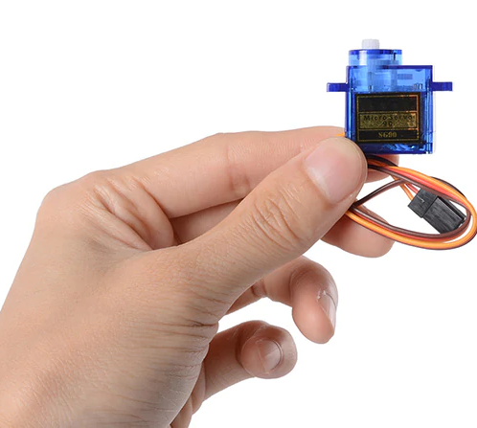
Micro
Servo

Slide 19
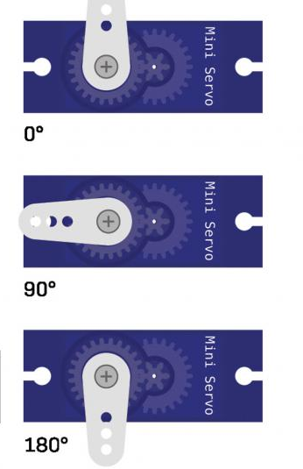
Servo motor
It is a type of actuator that can rotate (usually between 0° and 180°). it is used to control the angular position, in the center position it can rotate approx. 90° to the left and 90° to the right. (If you force beyond this limits the gears will break)
Otto in the starter kit has 4 servo motors that collectively help the robot walk and make multiple dances.

Slide 20
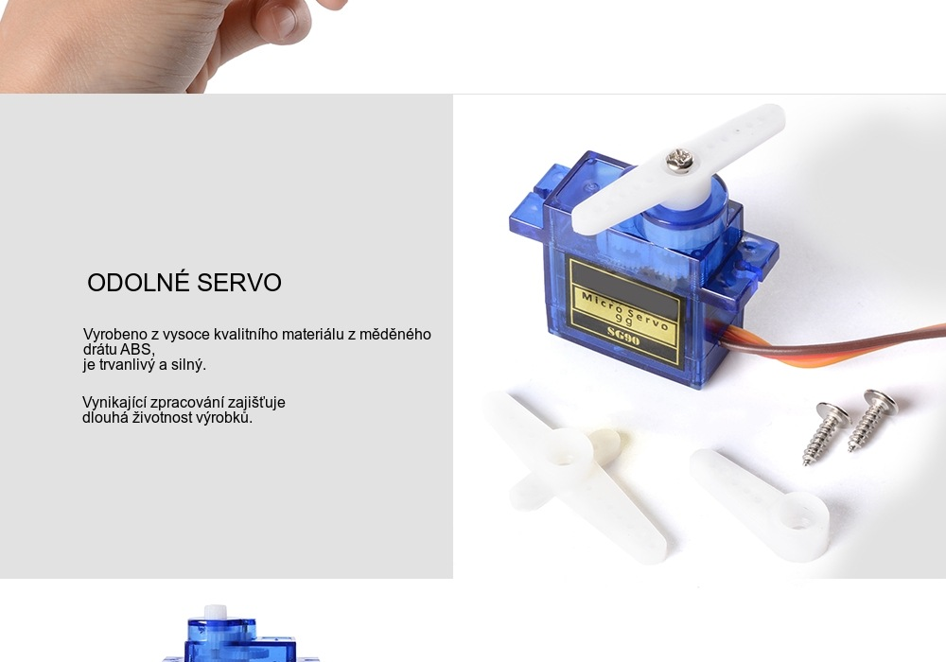

Servo motors care
NEVER force them, this will DAMAGE them, specially the plastic ones. The best is not to rotate their arms by hand and use code to center/align them.
Look at the color of the cables before connecting them and make sure always they are in the right orientation.
When disconnecting do not pull the cables, always grab them from the black connector and gently take out.

Slide 21
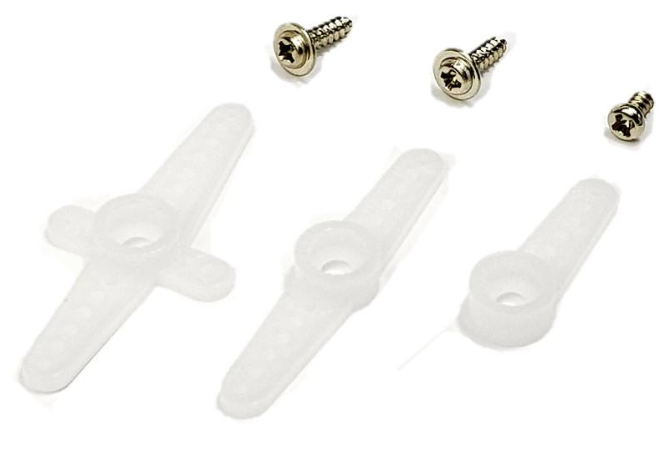
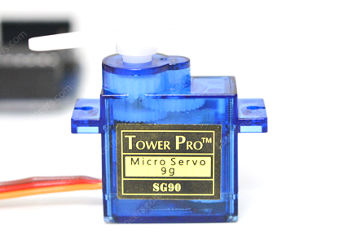
It comes with 3 screws:
2 for mounting (long & pointy)
1 for center horn (short & flat)
and
3 horns / arms “white keys”
we only need 1 horn per servo, the other 2 are extra spare parts.

Slide 22
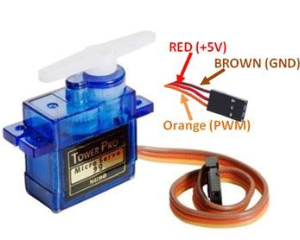
Servo motor have 3 pins:
GND ground pin (typically brown or black) connects to G (0V)
Voltage pin (typically red)
connects to V (+5V)
PWM signal pin (typically orange or white) receives the control signal, connects to the S of a determined pin number.

Slide 23
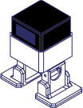
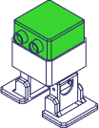
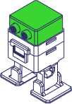
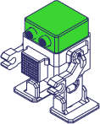
Original instructions
Failure to read the guide may lead to inferior results, or damage to the robot. Always ensure that anyone who uses the robot knows and understands the contents of this guide.
We control the quality and parts in our original kits, but we cannot control the conditions in which you assemble but. For this, and other reasons, we do not assume responsibility, and expressly disclaim liability for loss, injuries, damage, or expense arising out of, or in any way connected with, the assembly, handling, storage, use or disposal of the product.
The information in this guide is provided without any warranty, expressed or implied, regarding its correctness.

Slide 24
Find all Instructions here:
ottodiy.com/academy
📚

Slide 25

Otto Blockly
As a good practice, you should check and test your electronics and software in your computer, before the final assembly of the robot, this avoid having to disassemble the whole robot later to fix something.
You can do this by connecting only the 4 servos, as indicated in the wiring.
If you have not download nor installed Otto Blockly this is the moment! Download latest Otto Blockly version from here
If you are more experienced you can follow the guide for Arduino in this link.

Slide 26
Otto Assemble!
Now that we are sure everything is working including the software and your PC, we can build our robot.

Slide 27
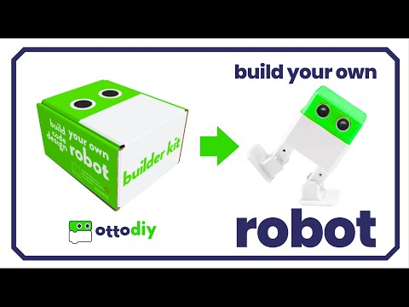
How to
build?
*some of parts like the
electronic board
and battery might vary
in your kit, but the principle
of assembly is the same

Slide 28
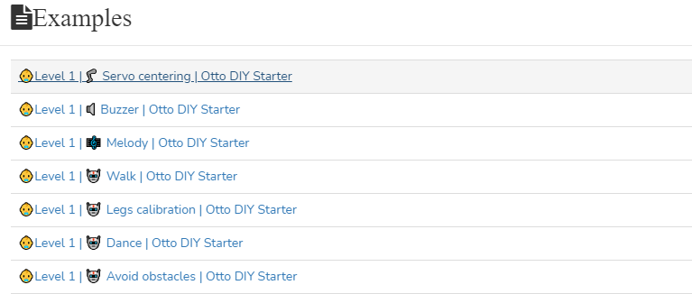
Open the Servo centering example

Slide 29
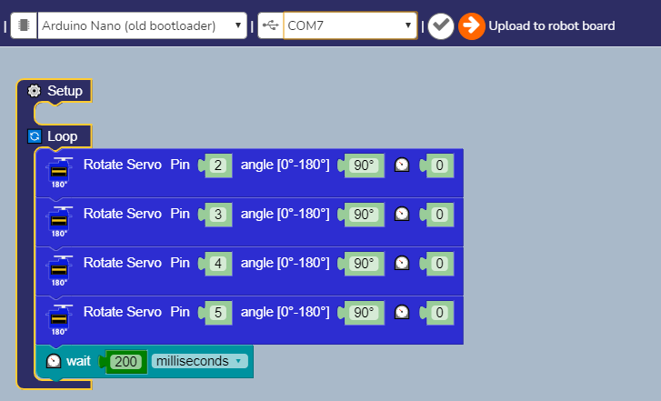
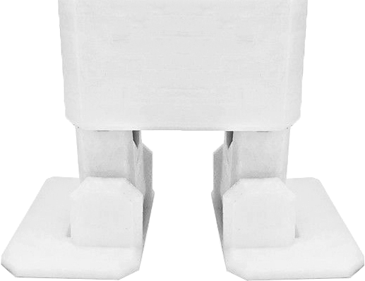
Upload code
After upload the code the feet must be aligned and centered as much as possible, if not you must re-assemble the servos in the right angle, back to step 4 and 6.

Slide 30
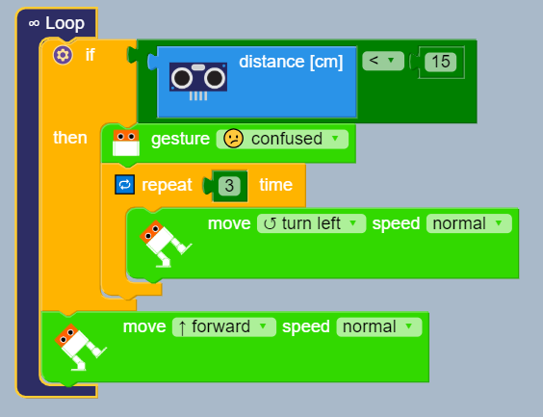
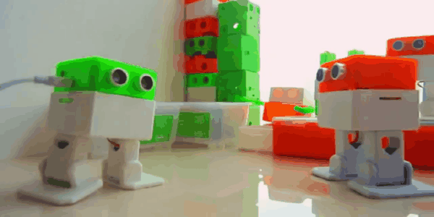
How to code?
Otto Blockly guide
Notes:
Otto can walk, dance, avoid obstacles, make sounds and is completely programmable with simple coding blocks.

Slide 31

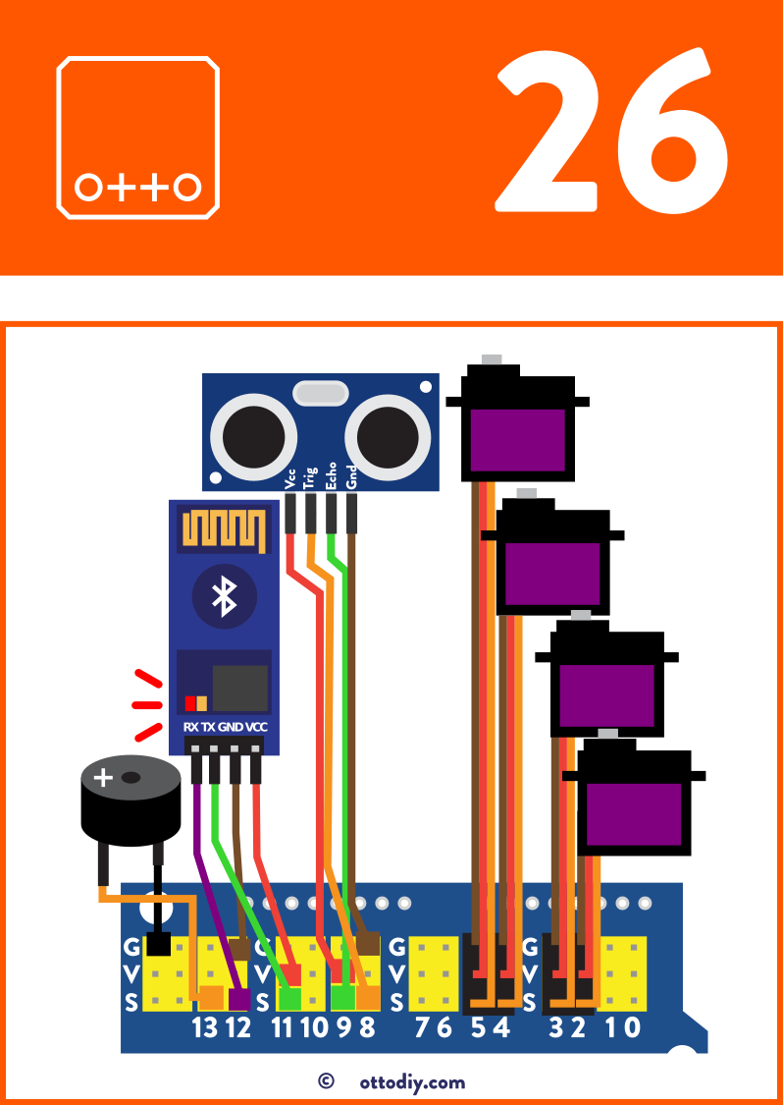
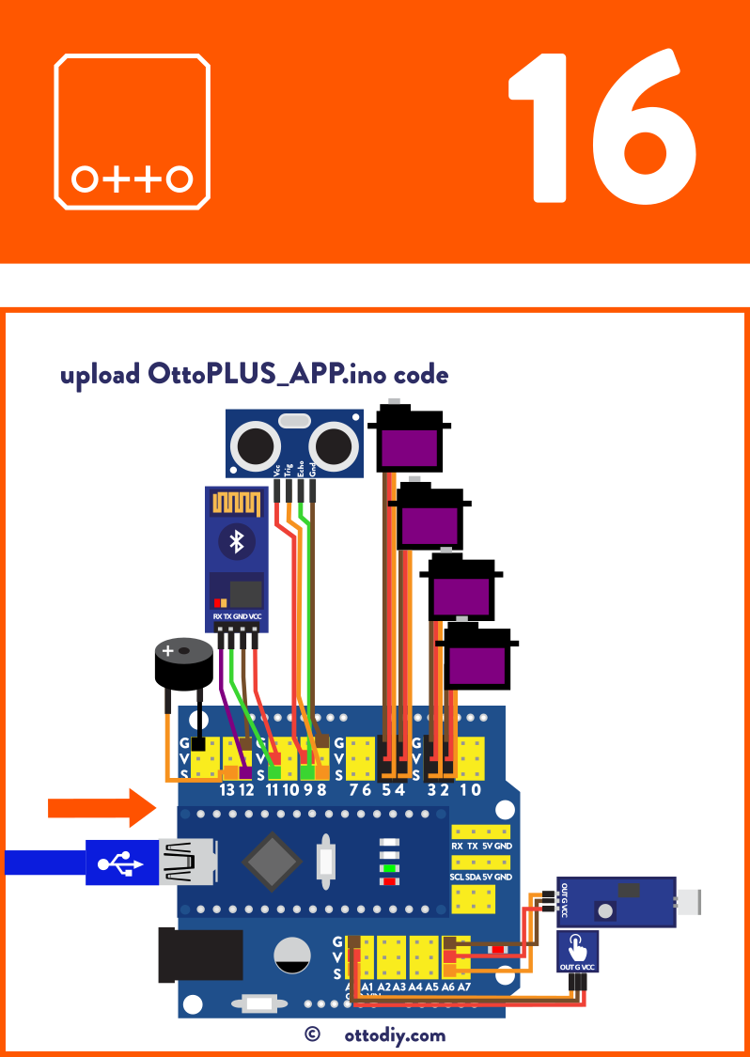
Remote App*
Bluetooth guide
*Purchase the Bluetooth module separate or already included in the plus kit

Slide 32
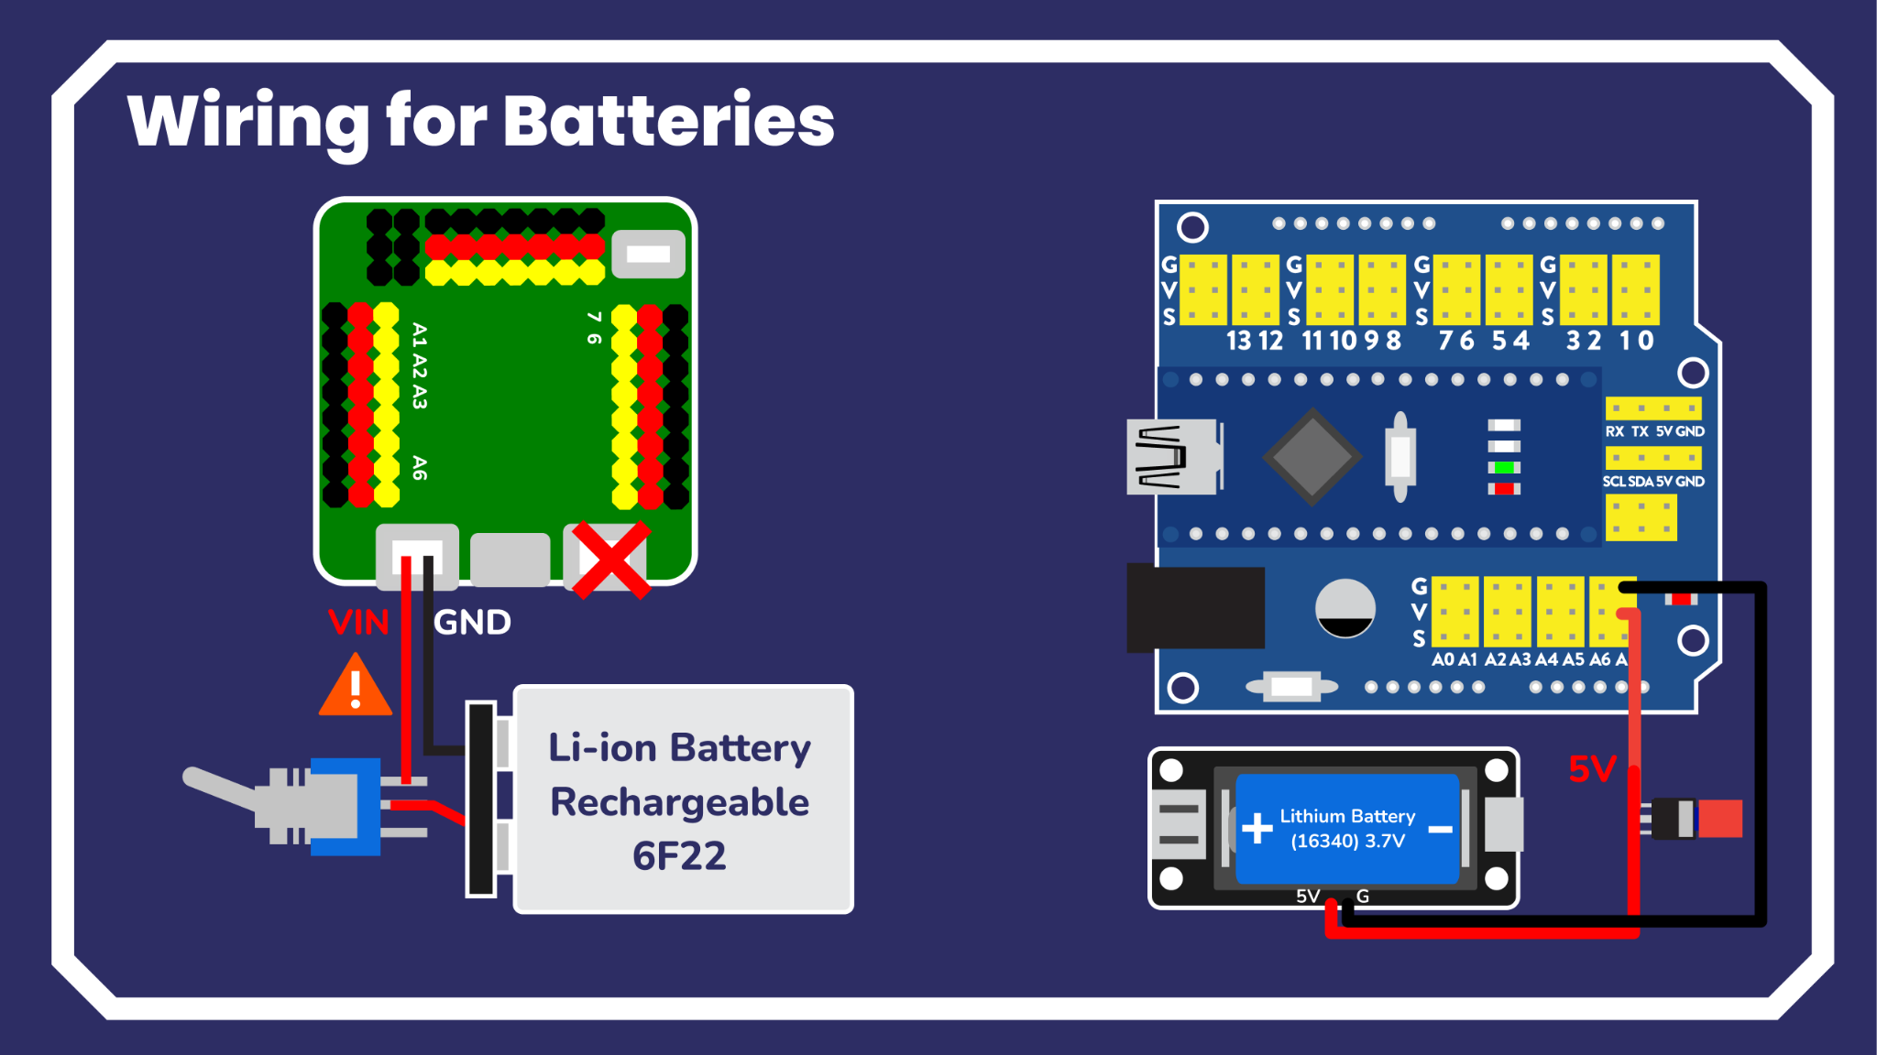

Slide 33
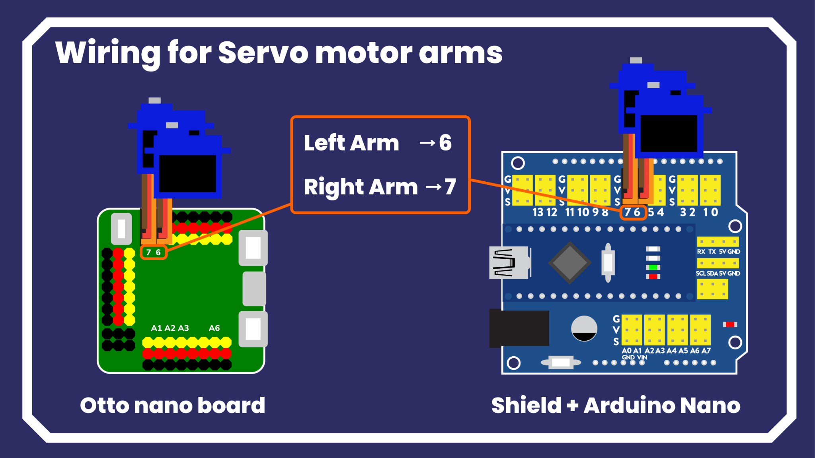

Slide 34
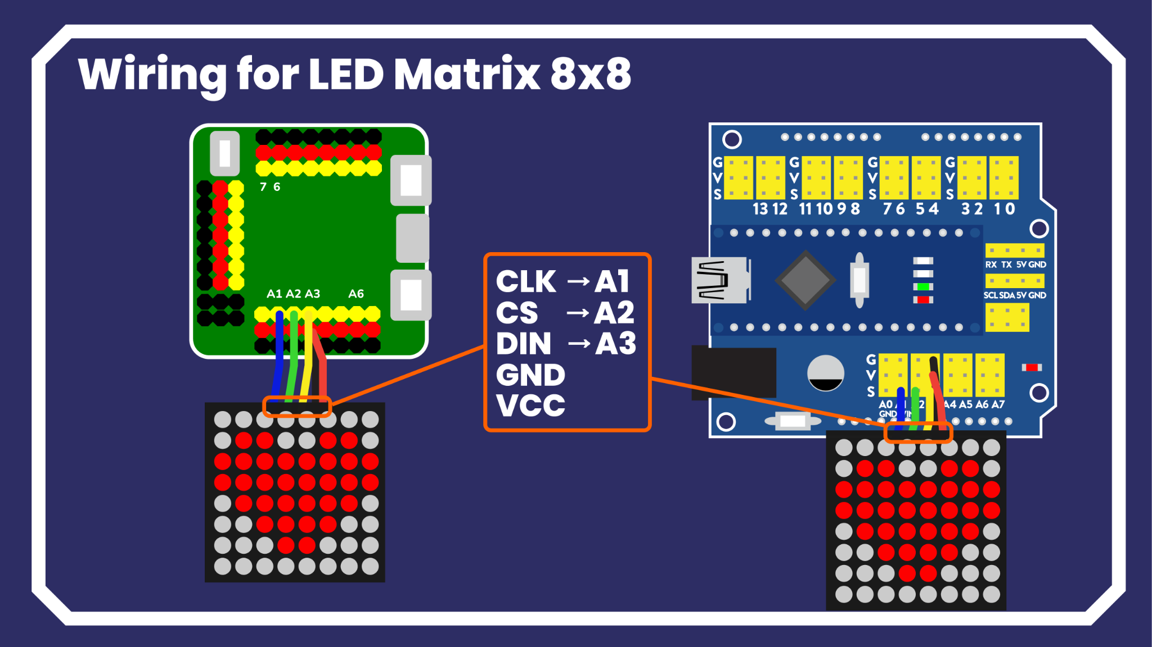

Slide 35
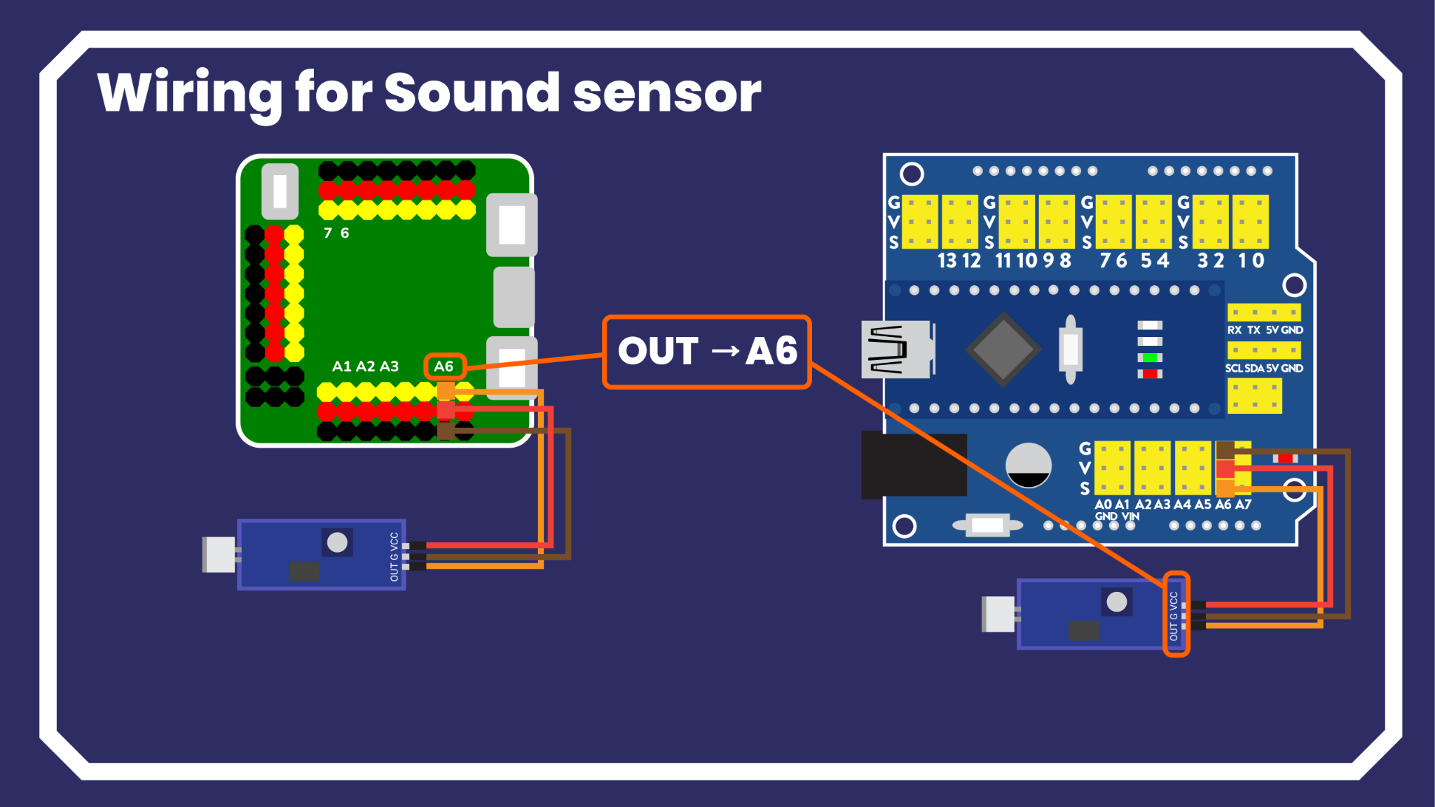

Slide 36
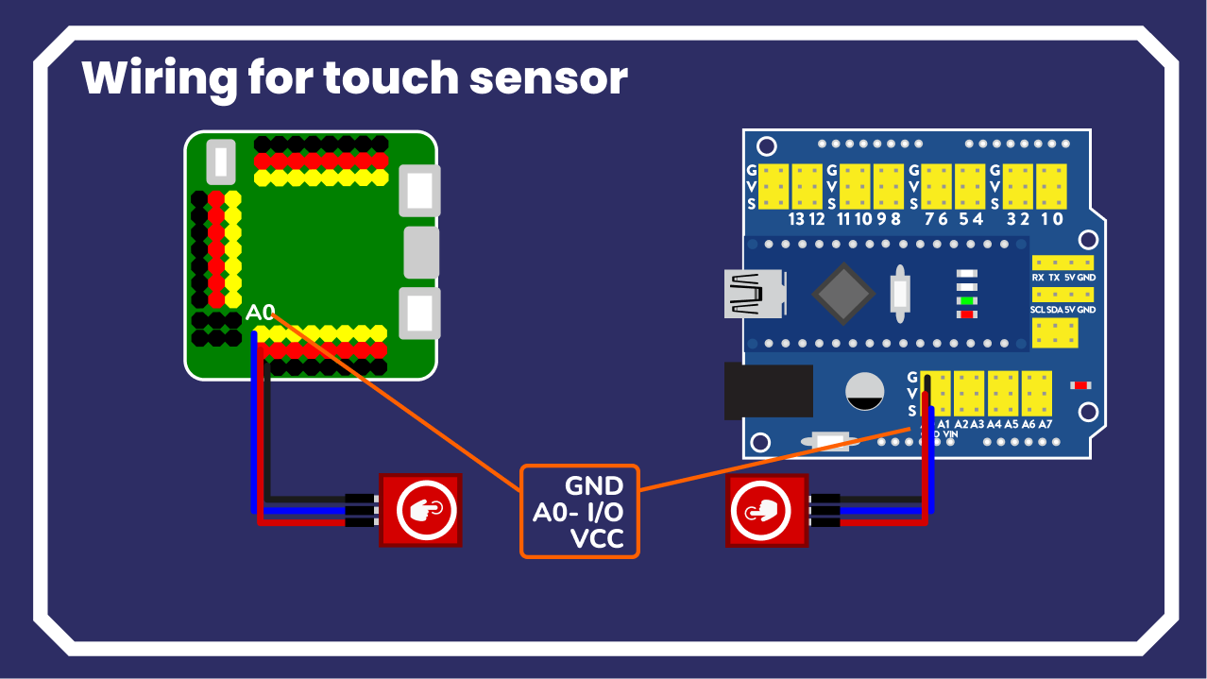
⚠️Pin order might vary!

Slide 37
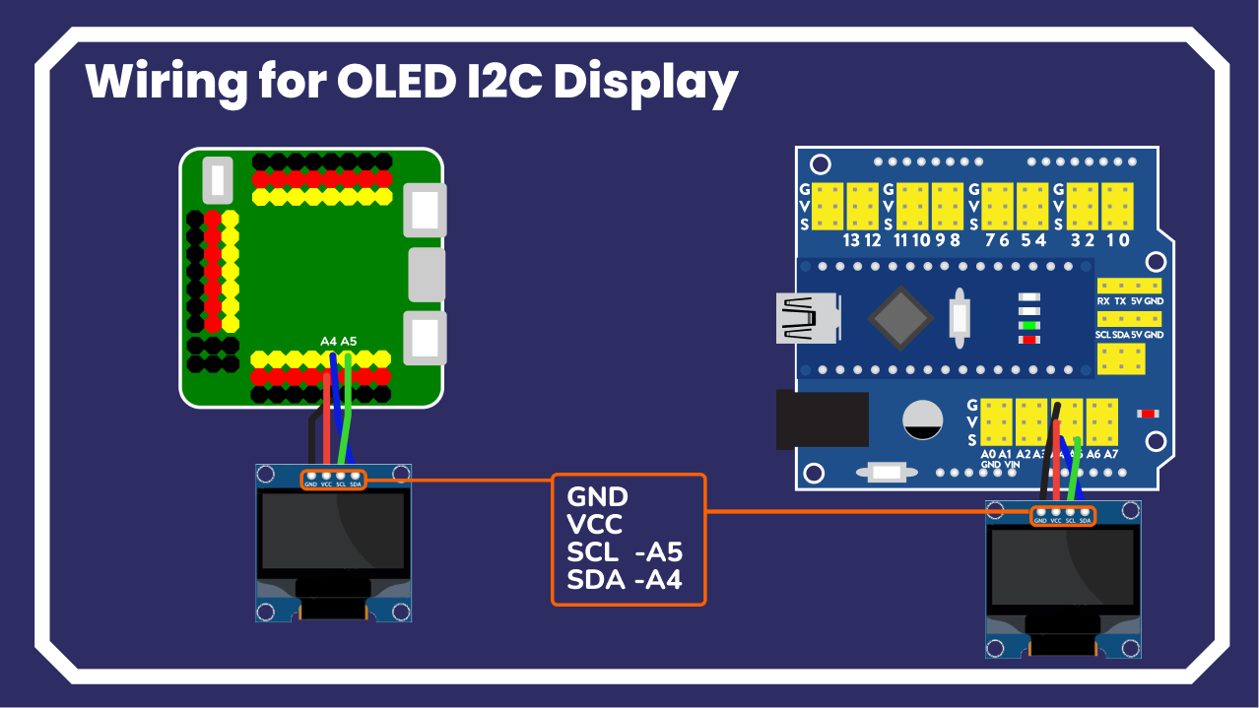
⚠️Pin order might vary!

Slide 38
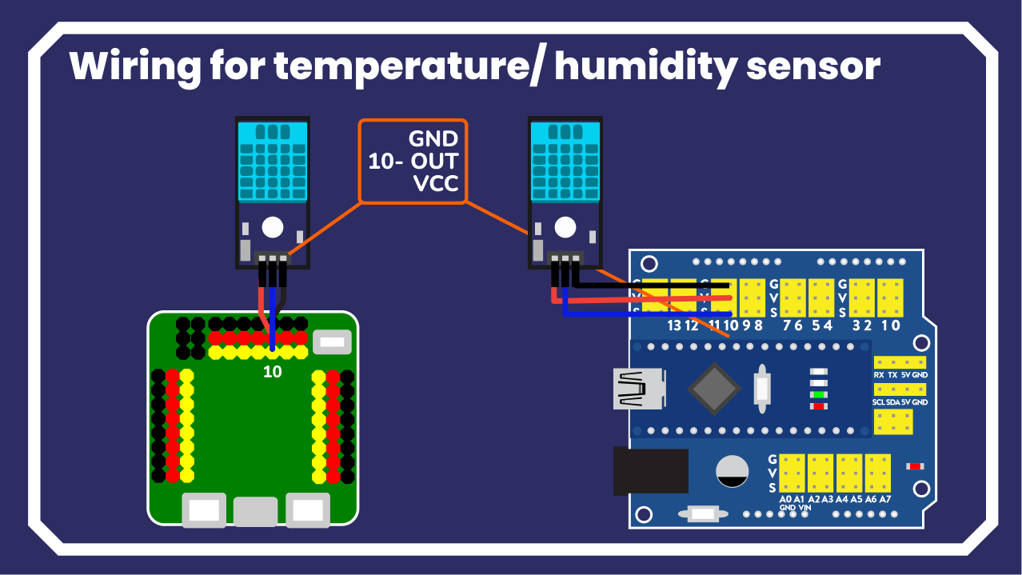

Slide 39

Wiring shield + nano
This is the electronic diagram of all components you can expand your robot with our kits, since Otto is now a modular robot, you can plug or unplug them to have more or components as you decide and just change the Pins in Otto Blockly.
Components like the 16x8 LED matrix for the eyes can be interchanged for and OLED display or any other I2C device.
Touch you can swap to any other digital sensor.
Sound you can swap to any other analog sensor.

Slide 40

Wiring nano board
Works same as the combination of nano+shield in a smaller size with colored pins.
Servo Left Leg or Left Wheel 2
Servo Right Leg or Right Wheel 3
Servo Left Foot 4
Servo Right Foot 5
Ultrasonic Trigger 8
Ultrasonic Echo 9
Bluetooth TX 11
Bluetooth RX 12
Buzzer Positive Pin 13
Touch sensor or Button OUT A0
Sound sensor OUT A6 or A3
Left arm for Humanoid 6
Right arm for Humanoid 7
LED MATRIX mouth CLK Clock A1
LED MATRIX mouth CS Chip Select A2
LED MATRIX mouth DIN Data In A3
LED MATRIX eyes or OLED SDA Synchronous Data A4
LED MATRIX eyes or OLED SCL Synchronous Clock A5

Slide 41

3D modeling design
Design assets

Slide 42




Paper Crafts to customize

Slide 43




























There are more than 100 remixes waiting for you
Encouraging the future generations to become creators

Slide 44




Community contests and competitions

Slide 45


Otto Builder community 🤗
builders.ottodiy.com

Slide 46
Warranty
Wear and tear category components are excluded from this warranty.
The warranty period begins with the day when the customer receives the goods. Neither the Seller's liability for defective products nor the quality warranty applies to robots or parts damaged by handling, which is in conflict with the instructions and recommendations in the official manuals and guides, or improper handling caused by unofficial modifications, such as modifications to hardware or software.

